Slide 1
CRITICAL VULNERABILITIES

Slide 2
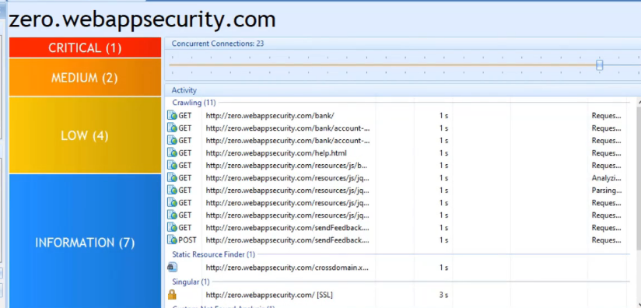
VULNERABILITIES IN ZERO.WEBAPPSECURITY.COM

Slide 3
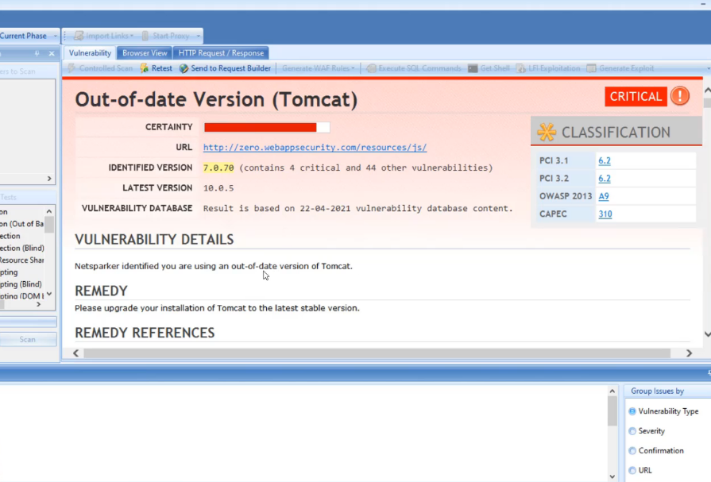
VULNERABILITY DESCRIPTION NETSPARK

Slide 4
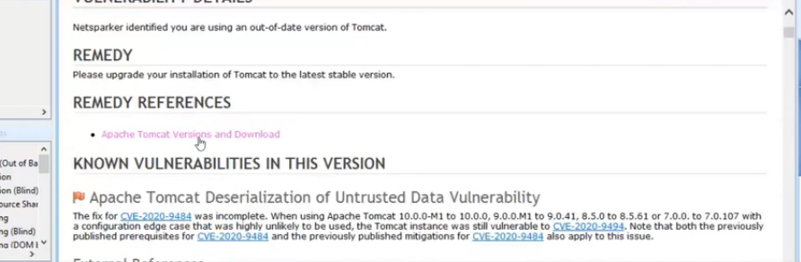
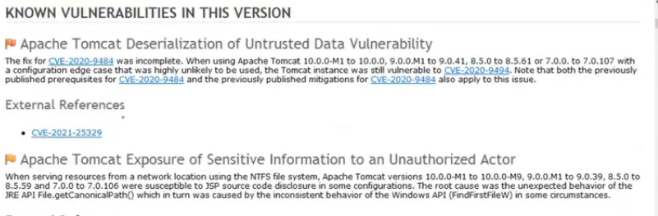

Slide 5
VULNERABILITY DETAILS:
Vulnerability details:
YOU ARE USING OUT OF DATE VERSION OF TOMCAT.
Remedy for this vulnerability:
Please upgrade your tomcat to the latest software stsble version.
There are some known vulnerabilities in this version:
->Apache tomcat deserialization of untrust data vulnerability
->Apache tomcat exposure of sensitive information to unauthorzied actor
Remedy:
Finally to resolve this issue please upgrade your tomcat to the latest stable version.

